Slide 1



Construire son infrastructure sur Azure, un jeu d’enfant
aOS Monaco
26/09/2019
Yoann GUILLO

Slide 2





aOS Monaco 26/09/2019
MERCI à nos sponsors

Slide 3

HELLO!
Yoann Guillo – Architecte Cloud Azure - Rennes
MVP Azure / Freelance
Membre de la communauté aOS & MUG Rennes
Retrouvez moi sur Twitter @YoannGUILLO
Sur mon blog www.geneziis.com
Sur LinkedIn : https://www.linkedin.com/in/yoannguillo

Slide 4
THIS IS A SLIDE TITLE
Here you have a list of items
And some text
But remember not to overload your slides with content
Your audience will listen to you or read the content, but won’t do both.

Slide 6
Bien démarrer

Slide 7


Extensions VsCode
https://marketplace.visualstudio.com/items?itemName=msazurermtools.azurerm-vscode-tools
https://marketplace.visualstudio.com/items?itemName=samcogan.arm-snippets

Slide 8

Extensions VsCode
https://marketplace.visualstudio.com/items?itemName=wilfriedwoivre.arm-params-generator

Slide 9
Liens utiles
Azure Quickstart Templates
Azure Quickstart Templates (Github)
Resource Manager on Microsoft Docs
What is Resource Manager ?
Utiliser « Template reference »
Template reference (la bible)
Template best practices
Azure Resource Manager template functions

Slide 10

Extraction depuis le portail
Image by Ola Wirdenius from Pixabay

Slide 11
Export template

Slide 12

Je templatise, tu templatises…
Image by Julius Silver from Pixabay

Slide 13
Déployer mais à quel niveau ?
Souscription
Resource Group
Resource

Slide 14
Déploiement niveau souscription
Déployer un Resource Group via template
https://docs.microsoft.com/en-us/azure/azure-resource-manager/deploy-to-subscription
Déployer des ressources au sein d’un RG via les Nested templates
https://docs.microsoft.com/en-us/azure/azure-resource-manager/deploy-to-subscription#create-resource-group-and-deploy-resources

Slide 15
Utilisation des fonctions ARM
Copy
https://docs.microsoft.com/bs-latn-ba/azure/azure-resource-manager/resource-group-create-multiple
Condition
https://docs.microsoft.com/en-us/azure/architecture/building-blocks/extending-templates/conditional-deploy

Slide 16
Utilisation des fonctions ARM
User defined functions
https://docs.microsoft.com/en-us/azure/azure-resource-manager/resource-group-authoring-templates#functions
Outputs
https://docs.microsoft.com/en-us/azure/azure-resource-manager/resource-group-authoring-templates#outputs

Slide 17

Déploiement automatisés depuis Azure DevOps
Photo by Kit Suman on Unsplash

Slide 18
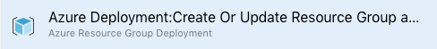
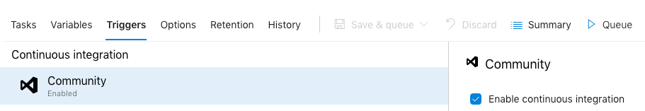
Azure DevOps
Chaine de déploiement d’un template ARM depuis Azure DevOps :
https://docs.microsoft.com/en-us/azure/devops/pipelines/apps/cd/azure/deploy-provision-azure-vm?view=azure-devops

Slide 19

MERCI POUR VOTRE ATTENTION
https://github.com/YoannGUILLO/Community/tree/master/aOS%20Monaco%20September%202019
Photo by Kit Suman on Unsplash

